Slide 1
Advanced Shot Chart
Augustinas Dankevicius
Student ID: 4335506
Notes:
Good afternoon my name is Augustinas
And today I will be talking about basketball

Slide 2
Presentation’s Content
What is a shot chart?
Why do we need to improve the shot chart?
Is it interesting? ..Is it difficult?
So how are you going to do it?
How did it go?
Any plans for future work?
Notes:
So the content of today’s presentation is this:
First, I am going to talk a bit about the standard ways of visualizing basketball shots
Next, I will explain a few areas where shot chart could be improved, which is also the main motivation behind solving this problem
After that we will see what makes it interesting or not, and whether or not it is a difficult problem to solve?
Then we’ll talk about my solutions to this huge issue,
Present the results
And suggest areas of improvement

Slide 3
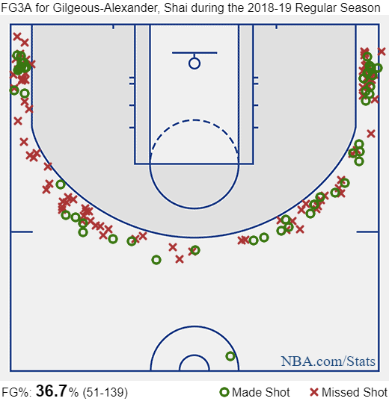
Shot Chart
Not very exciting
Taken directly from nba.com
Notes:
Here we see a standard shot chart visualization
Green circles indicate a made shot
Red crosses indicate a missed shot
While it does a decent job at showing the shooting tendencies, personally, I think it’s a little sad and boring.. There’s not much colours, Or anything else really
Powerful tools available for information visualization are not exploited
Believe it or not this is from nba.com

Slide 4
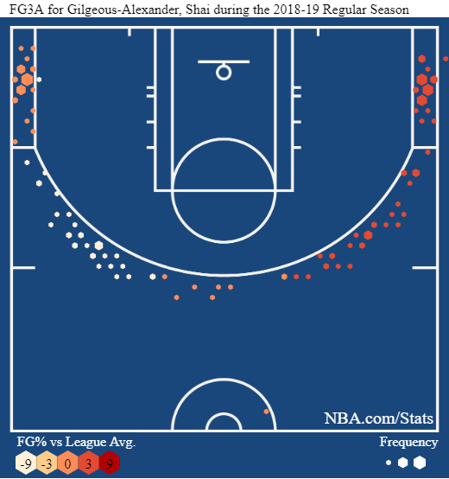
Hexagon Chart
Essentially an improved shot chart
Condenses two variables
More exciting
Could it be even more exciting?
Notes:
Next we see a hexagon plot
IMO, Much better than shot chart in both information visualized as well as style
Size of hexagon indicates shot frequency from a given location, the colour indicates shooting performance compared to league average
Definitely more visually pleasing
But can it be even better?

Slide 5
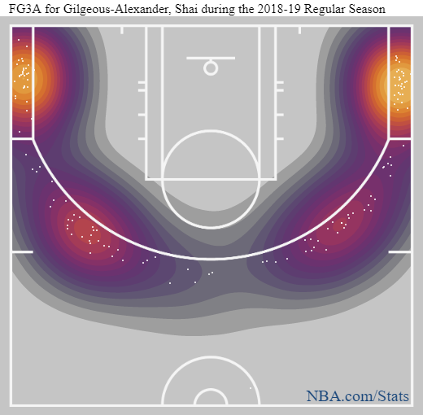
Heat map
It’s exciting, but..
Doesn’t portray information well
Could it be even more exciting?
Notes:
Well, sort of..
Here is a heat map which uses kernel density estimation to show “hot” shooting areas
Definitely more exciting BUT
A bit confusing and hard to interpret
Is it possible to make it even better????
Essentially, at this point we are trying to find ways of portraying basketball shooting statistics in a fashionable way

Slide 6
So how can we make it better?
Add effects?
Interactivity?
More colours?
Make it 3D?
<- Winner!
Notes:
So what can we do about it?
Maybe add visual effects?
Or make it interactive?
More colourful?
Or… make it 3D???????????
Yep, let’s make it 3D

Slide 7
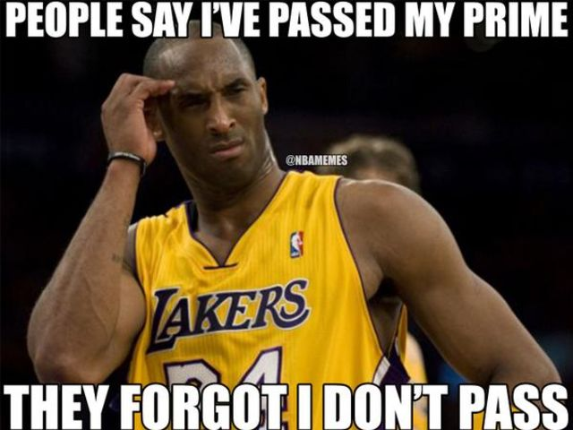
Basketball statistics are boring!
No, they are not
It’s a game, it’s fun
Plenty of room for creative solutions
Notes:
So the title reads Basketball statistics are boring and I have a counter argument for it
Which is: They are not
It is a game of basketball, and it’s fun
The data behind it is interesting and has many ways to find all kinds of interesting trends etc
There’s also plenty of room for creative solutions, which I think info viz is all about

Slide 8
Sounds easy!
It really isn’t
Many variables to account for
Hard to come up with novel methods
Hard to measure efficiency
But let’s try anyway
Notes:
So, is it a difficult task?
I can honestly say that no, it really isn’t
We have many variables to account for, and loads of data points to condense into a single visualization
It is also quite difficult to come up with an interesting way to present basketball statistics
And also difficult to measure efficiency of our visualizations
But lets’ give it a go

Slide 9
So, what’s the plan?
Create a new method or two to visualize basketball shots
Make it 3D
Compare it to standard shot charts
Decide if it’s any good
Notes:
So the plan of action is:
Brainstorm some ideas, choose the best ones
Make sure it’s 3D, for extra style points
Implement it and compare it to the shot chart
Make conclusions, simple

Slide 10
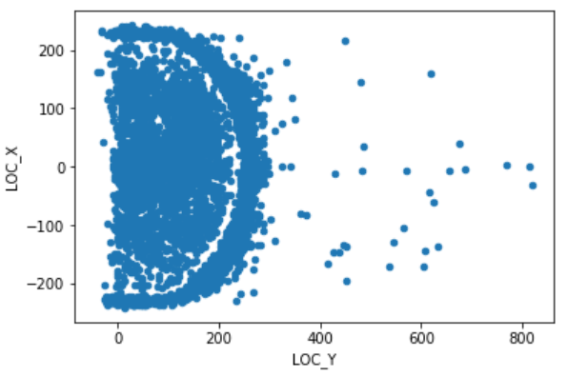
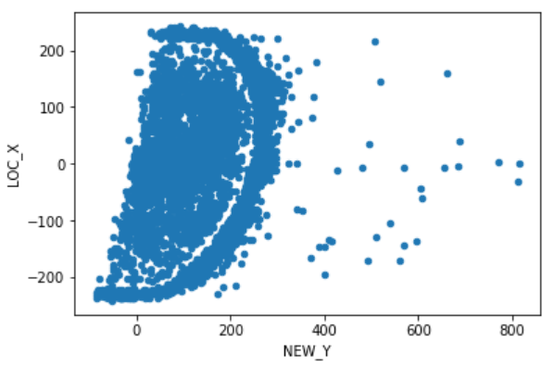
Implementation
Notes:
So how are we going to implement it?
Actual 3D visualization techniques exists but are way out of my league
So instead we are going to create 3D effect on a 2D plane
And the first step in doing so is skewing the data
On the left you can see data visualized in its’ raw form
And on the right you can see how skewing makes it look sort of 3D

Slide 11
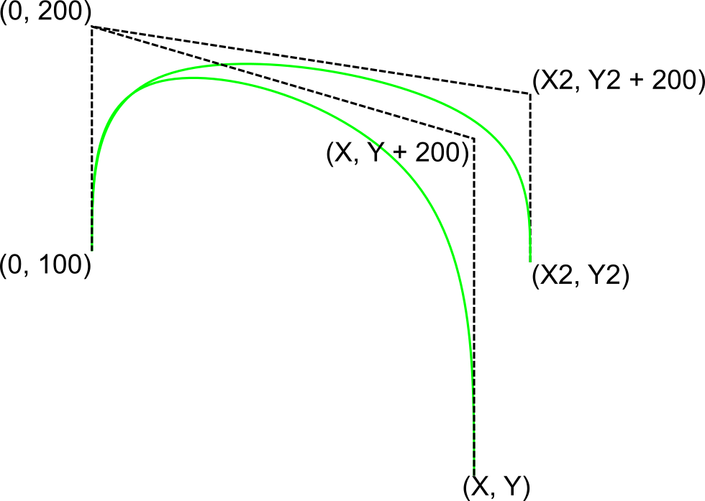
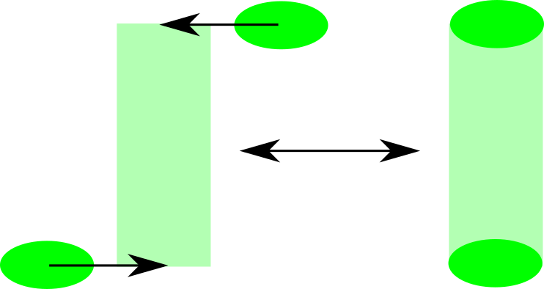
The idea (s) continued
Curve plot
Column plot
Notes:
Managed to brainstorm two ideas I liked
First one I called the curve plot
Which is basically – explain how it works
Next one is the column plot, where 3D effect is created by combining two basic shapes

Slide 12



Notes:
The software used to implement the solutions is:
Python for getting and pre-processing the data
D3 javascript library for actual visualization
And R for bit more data processing

Slide 13
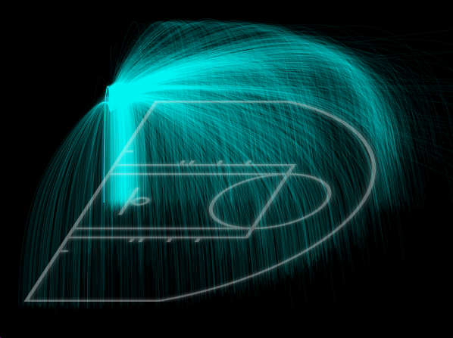
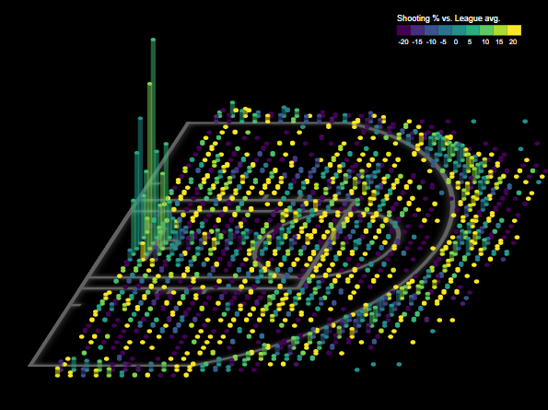
Results
Notes:
So here are the results:
Explain curve
Explain column

Slide 14
Demo time!
Notes:
Demo bitch

Slide 15
Future work
Better interface
Include different statistics
More seasons, regular/playoff option
Optimize performance
Experiment with viewing angle
Experiment with curve attributes
Notes:
yup

